Slide 1
Lecture 17
Dynamic tables and amortized analysis
EECS-214

Slide 2
Dynamic arrays
pointer to current array
Just an object with a pointer to an array
The array stores the real data
When you need to change the size
  Make a whole new array
  Copy the data
  Change the pointer
original array
containing the data
updated
pointer
new array with extra element

Slide 3
Dynamic array in C#
public class DynamicArray
{
object[] realArray = new object[0];
// Add an element at end
void Add(object newValue)
{
object[] newArray
= new object[realArray.Length + 1];
for (int i = 0; i < realArray.Length; i++)
newArray[i] = realArray[i];
newArray[realArray.Length] = newValue;
realArray = newArray;
}
… other methods …
}

Slide 4
Adding 10 elements
Step | Elements copied | Total copies
a = new DynamicArray() | 0 | 0
a.Add(1) | 0 | 0
a.Add(2) | 1 | 1
a.Add(3) | 2 | 3
a.Add(4) | 3 | 6
a.Add(5) | 4 | 10
a.Add(6) | 5 | 15
a.Add(7) | 6 | 21
a.Add(8) | 7 | 28
a.Add(9) | 8 | 36
a.Add(10) | 9 | 45
O(n²) copies!

Slide 5
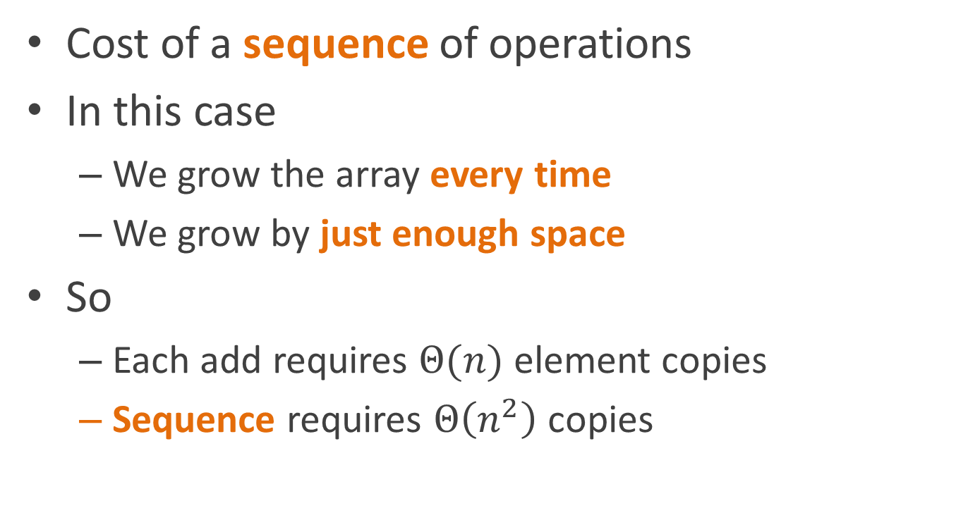
Aggregate analysis
Cost of a sequence of operations
In this case
  We grow the array every time
  We grow by just enough space
So
  Each add requires $Θ(n)$ element copies
  Sequence requires $Θ\left(n^{2}\right)$ copies

Slide 6
Adding more than we need
What if we
  Don’t grow the array every time
    Start with extra space
    Only grow when we run out of extra space
  Add extra when we do grow
Question: how much extra should we add?

Slide 7
How about if we grow by a lot, Like 1000 elements?

Slide 8
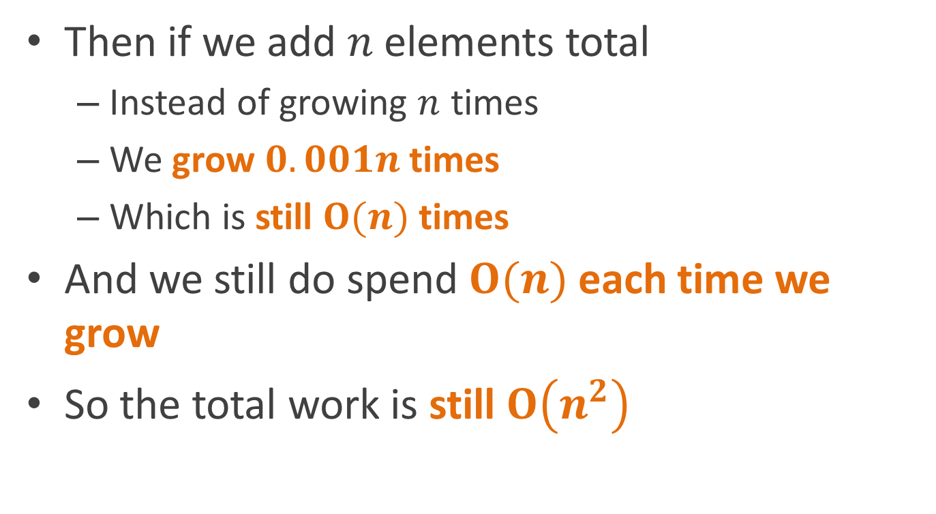
Growing by 1000 elements at a time
Then if we add $n$ elements total
  Instead of growing $n$ times
  We grow $0.001n$ times
  Which is still $O(n)$ times
And we still do spend $O(n)$ each time we grow
So the total work is still $O\left(n^{2}\right)$

Slide 9
What if we keep increasing the amount that we grow by?

Slide 10
Increasing the growth factor
If we increase the growth factor each time
Then we need to grow less frequently as time goes on
So it might cancel out …

Slide 11
Doubling the array size
public class DynamicArray
{
object[] realArray = new object[2];
int Count = 0;
// Add an element at end
void Add(object newValue)
{
Count++;
if (Count == realArray.Length) {
object[] newArray = new object[2*realArray.Length];
for (int i = 0; i < realArray.Length; i++)
newArray[i] = realArray[i];
realArray = newArray;
}
realArray[count-1] = newValue;
}
}

Slide 12
Adding 10 elements
Step | Elements copied | Total copies
a = new DynamicArray() | 0 | 0
a.Add(1) | 0 | 0
a.Add(2) | 0 | 0
a.Add(3) | 2 | 2
a.Add(4) | 0 | 2
a.Add(5) | 4 | 6
a.Add(6) | 0 | 6
a.Add(7) | 0 | 6
a.Add(8) | 0 | 6
a.Add(9) | 8 | 14
a.Add(10) | 0 | 14
n calls < 2n copies
O(n) copies!

Slide 13
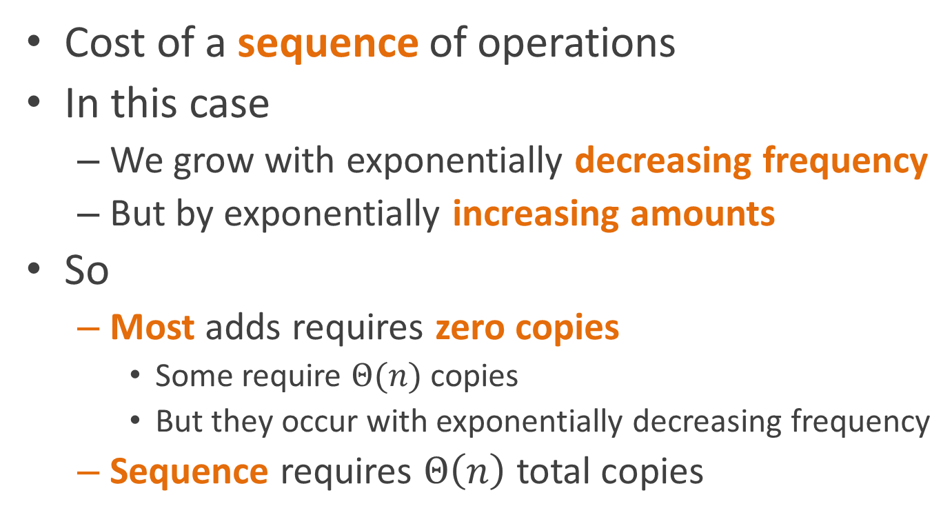
Aggregate analysis (handwavy version)
Cost of a sequence of operations
In this case
  We grow with exponentially decreasing frequency
  But by exponentially increasing amounts
So
  Most adds requires zero copies
    Some require $Θ(n)$ copies
    But they occur with exponentially decreasing frequency
  Sequence requires $Θ\left(n\right)$ total copies

Slide 14
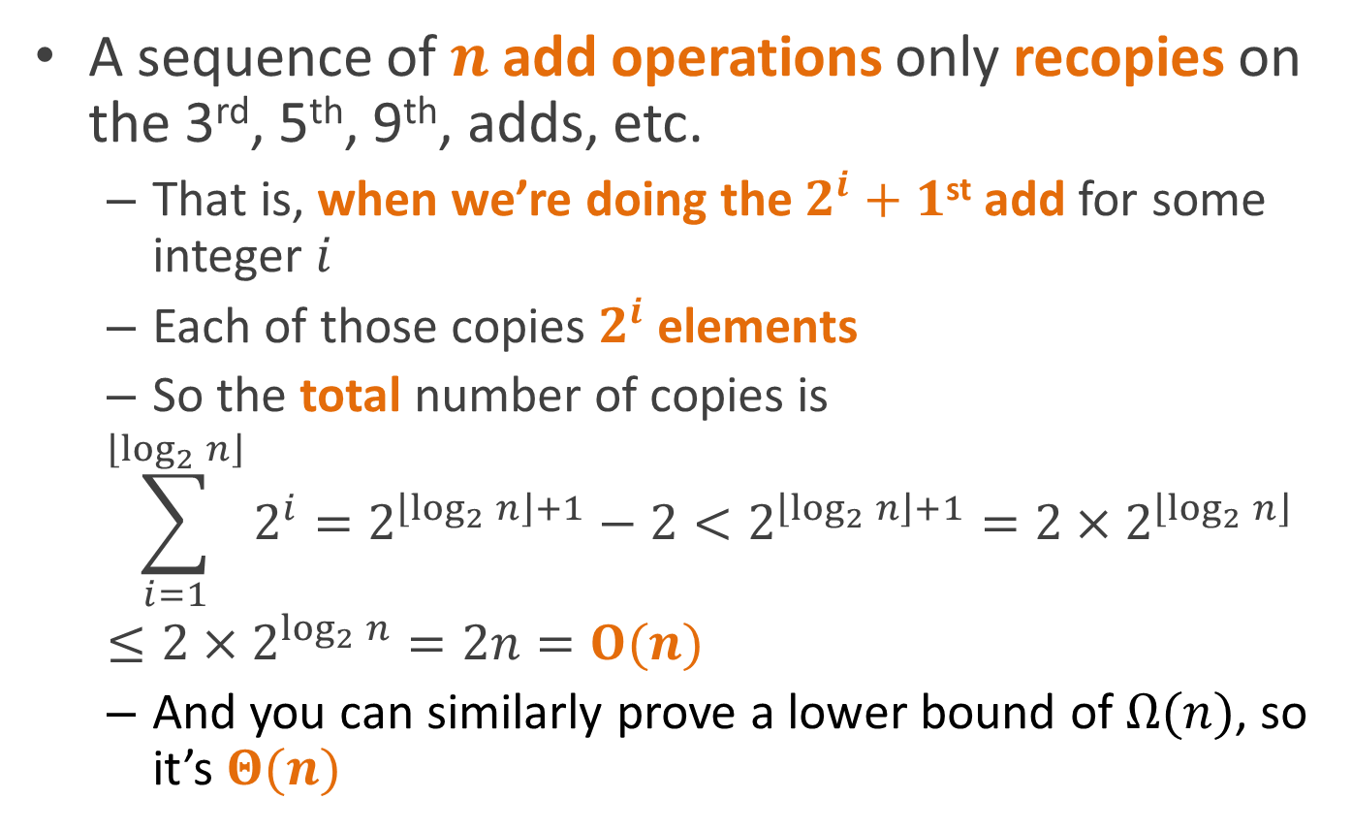
Aggregate analysis (formal version)
A sequence of $n$ add operations only recopies on the 3rd, 5th, 9th, adds, etc.
  That is, when we’re doing the $2^{i}+1$^{st} add for some integer $i$
  Each of those copies $2^{i}$ elements
  So the total number of copies is
  $$\sum_{i=1}^{\left\lfloor \log_{2}{n}\right\rfloor }{2^{i}}=2^{\left\lfloor \log_{2}{n}\right\rfloor +1}−2<2^{\left\lfloor \log_{2}{n}\right\rfloor +1}={2×2}^{\left\lfloor \log_{2}{n}\right\rfloor }≤2×2^{\log_{2}{n}}=2n=O(n)$$
  And you can similarly prove a lower bound of $Ω(n)$, so it’s $Θ(n)$

Slide 15
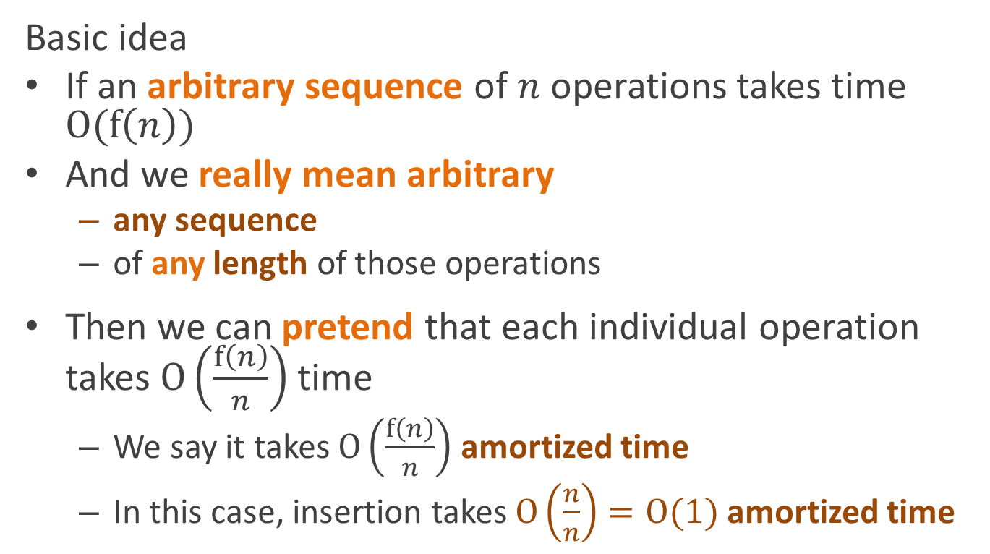
Amortized analysis
(using the aggregate method)
Basic idea
If an arbitrary sequence of $n$ operations takes time $O(f\left(n\right))$
And we really mean arbitrary
  any sequence
  of any length of those operations
Then we can pretend that each individual operation takes $O\left(\frac{f\left(n\right)}{n}\right)$ time
  We say it takes $O\left(\frac{f\left(n\right)}{n}\right)$ amortized time
  In this case, insertion takes $O\left(\frac{n}{n}\right)=O(1)$ amortized time

Slide 16

What’s the difference between?
Saying an algorithm takes $O(n)$ average time
And saying it takes $O(n)$ amortized time?

Slide 17
Average vs. amortized complexity
Average-case complexity
  Averages over possible inputs to a single call
Amortized complexity
  Averages over operations in a sequence of calls

Slide 18
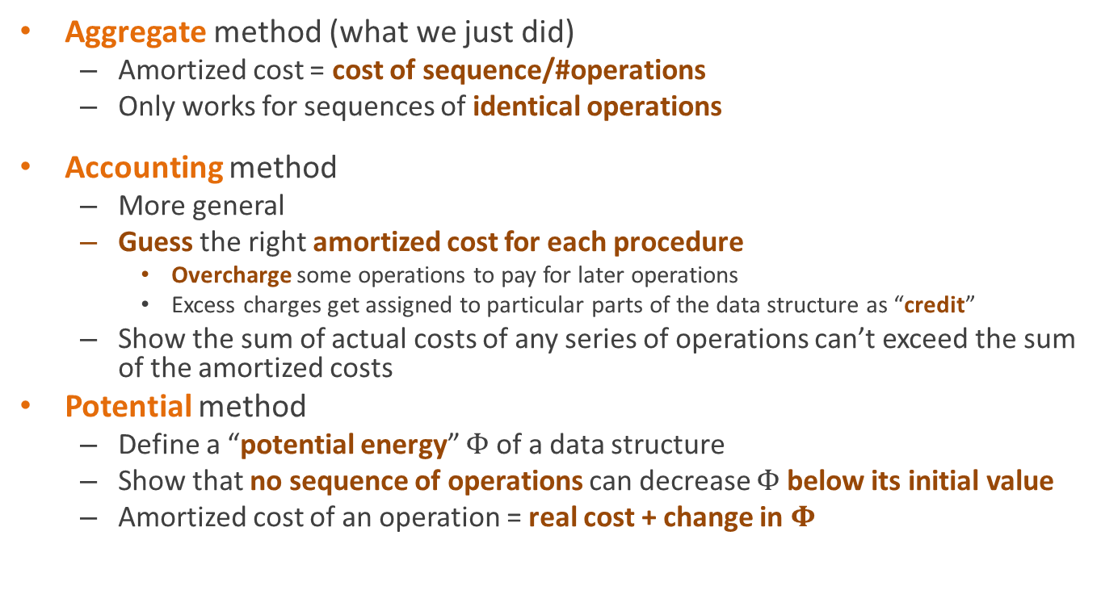
Methods for amortized analysis
Aggregate method (what we just did)
  Amortized cost = cost of sequence/#operations
  Only works for sequences of identical operations
Accounting method
  More general
  Guess the right amortized cost for each procedure
    Overcharge some operations to pay for later operations
    Excess charges get assigned to particular parts of the data structure as “credit”
  Show the sum of actual costs of any series of operations can’t exceed the sum of the amortized costs
Potential method
  Define a “potential energy” $Φ$ of a data structure
  Show that no sequence of operations can decrease $Φ$ below its initial value
  Amortized cost of an operation = real cost + change in $Φ$

Slide 19
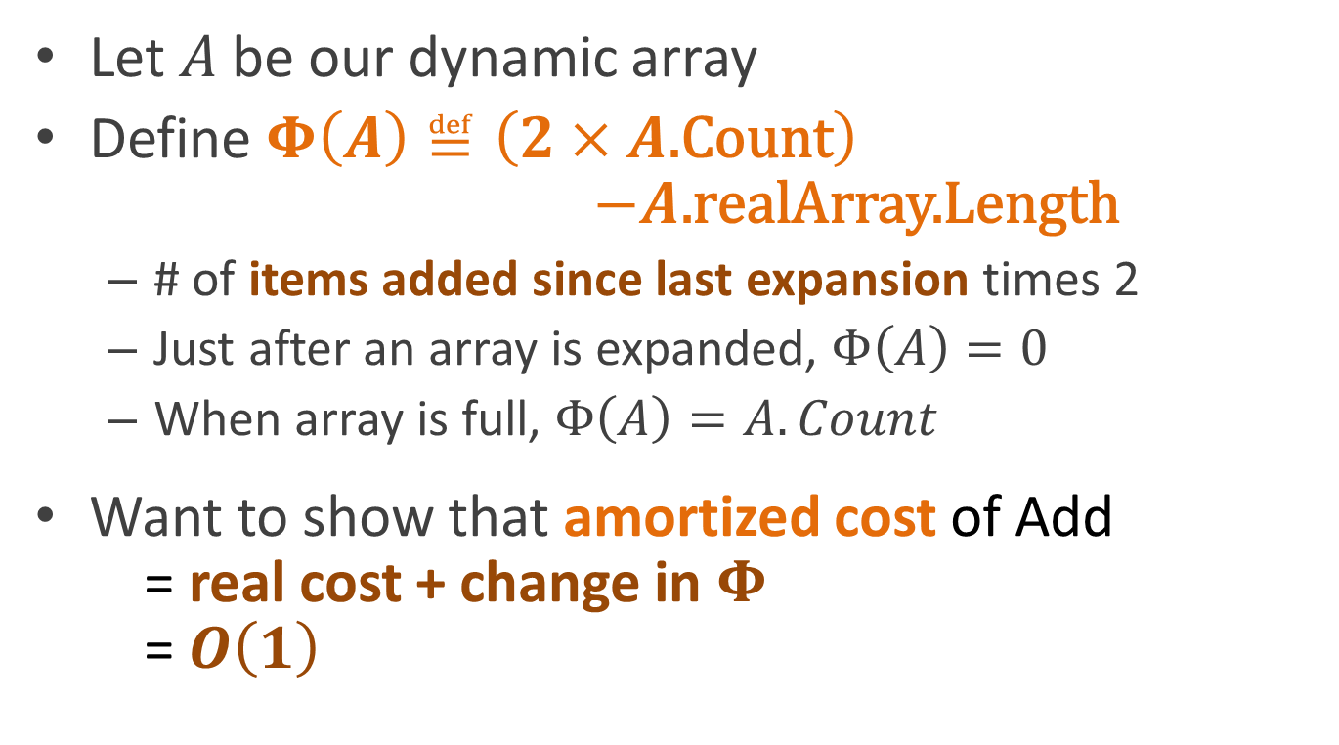
Using the potential method
Let $A$ be our dynamic array
Define $Φ\left(A\right)≝\left(2×A\text{.}\text{Count}\right)$
$−A\text{.}\text{realArray}\text{.}\text{Length}$
  # of items added since last expansion times 2
  Just after an array is expanded, $Φ\left(A\right)=0$
  When array is full, $Φ\left(A\right)=A.Count$
Want to show that amortized cost of Add
= real cost + change in $Φ$
=$O\left(1\right)$

Slide 20
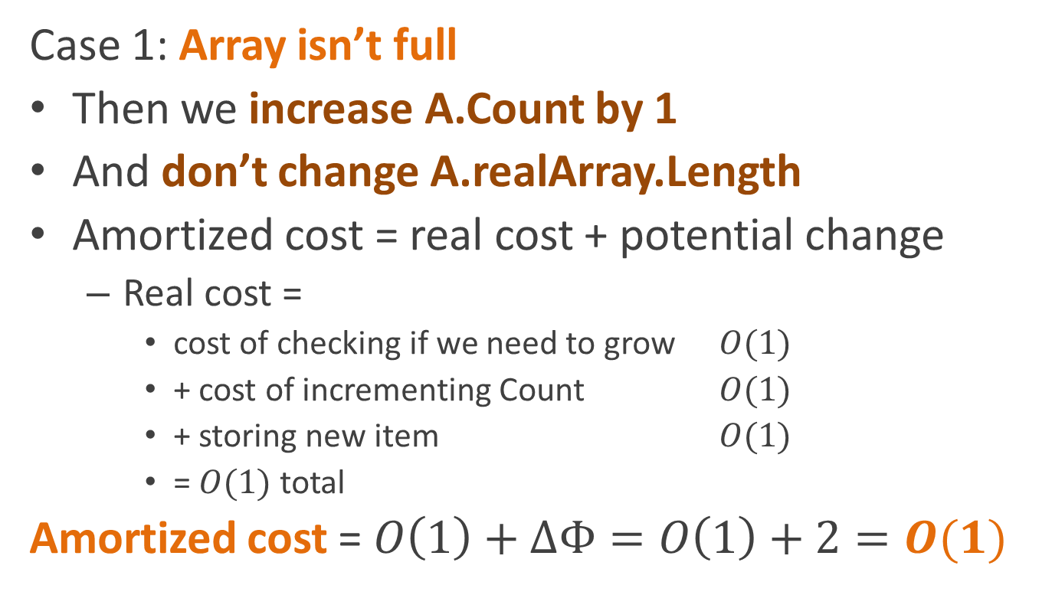
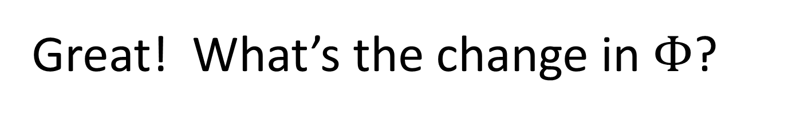
Great! What’s the change in $Φ$?
Case 1: Array isn’t full
Then we increase A.Count by 1
And don’t change A.realArray.Length
Amortized cost = real cost + potential change
  Real cost =
    cost of checking if we need to grow $O(1)$
    + cost of incrementing Count $O(1)$
    + storing new item $O(1)$
    = $O(1)$ total
Amortized cost = $O\left(1\right)+ΔΦ=O\left(1\right)+2=O(1)$

Slide 21
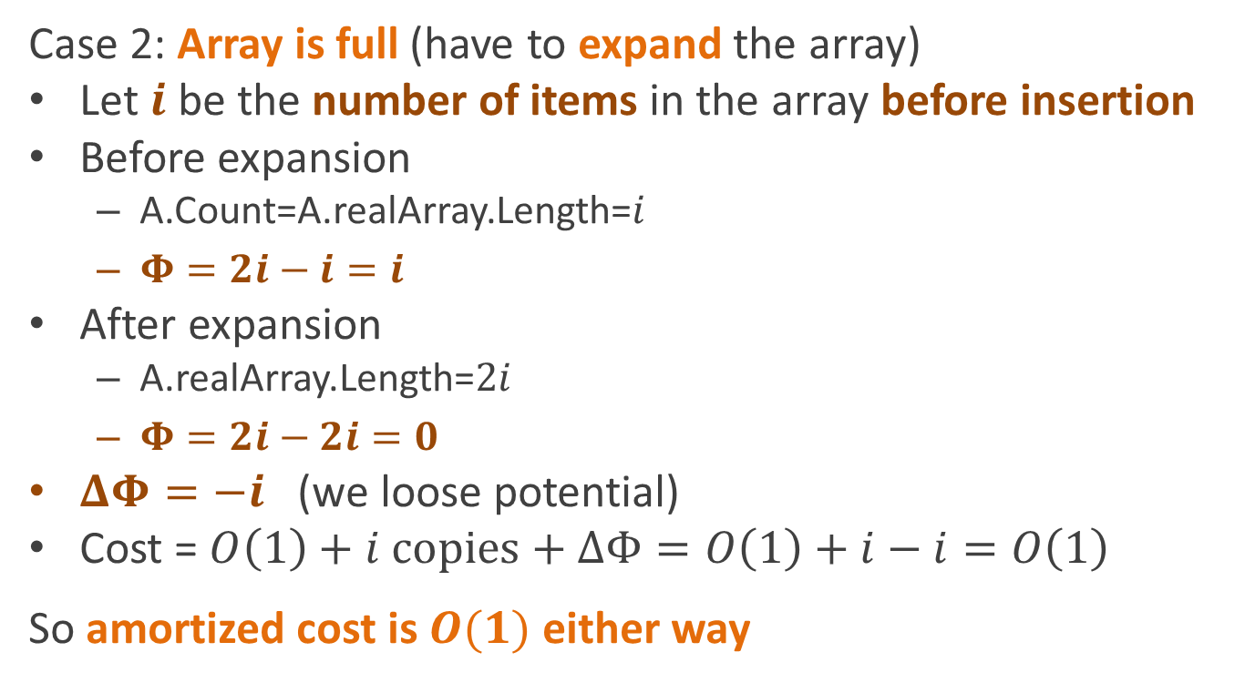
Great! What’s the change in $Φ$?
Case 2: Array is full (have to expand the array)
Let $i$ be the number of items in the array before insertion
Before expansion
  A.Count=A.realArray.Length=$i$
  $Φ=2i−i=i$
After expansion
  A.realArray.Length=$2i$
  $Φ=2i−2i=0$
$ΔΦ=−i$ (we loose potential)
Cost = $O\left(1\right)+i copies+ΔΦ=O\left(1\right)+i−i=O\left(1\right)$
So amortized cost is $O(1)$ either way

Slide 22
Shrinking the array
What if we want to support both Add and Remove (from the end)
  And we want it to shrink the table automatically if it’s too big
Analysis is hairier
  See section 17.4 in book, if you’re curious
Take home message:
  Double the array size when full
  Halve it when the array is only ¼ full

Slide 23
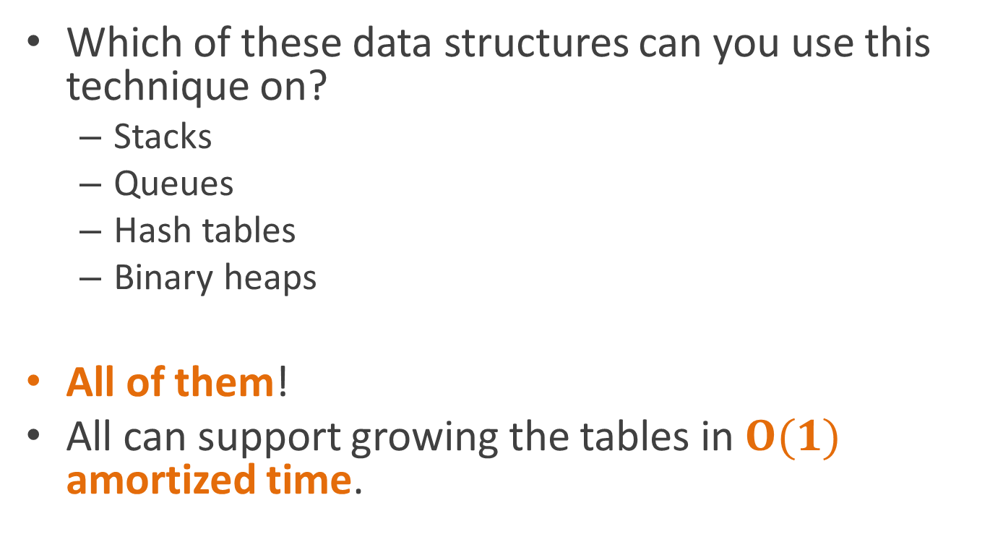
Applying to other kinds of tables
Which of these data structures can you use this technique on?
  Stacks
  Queues
  Hash tables
  Binary heaps
All of them!
All can support growing the tables in $O(1)$ amortized time.

Slide 24
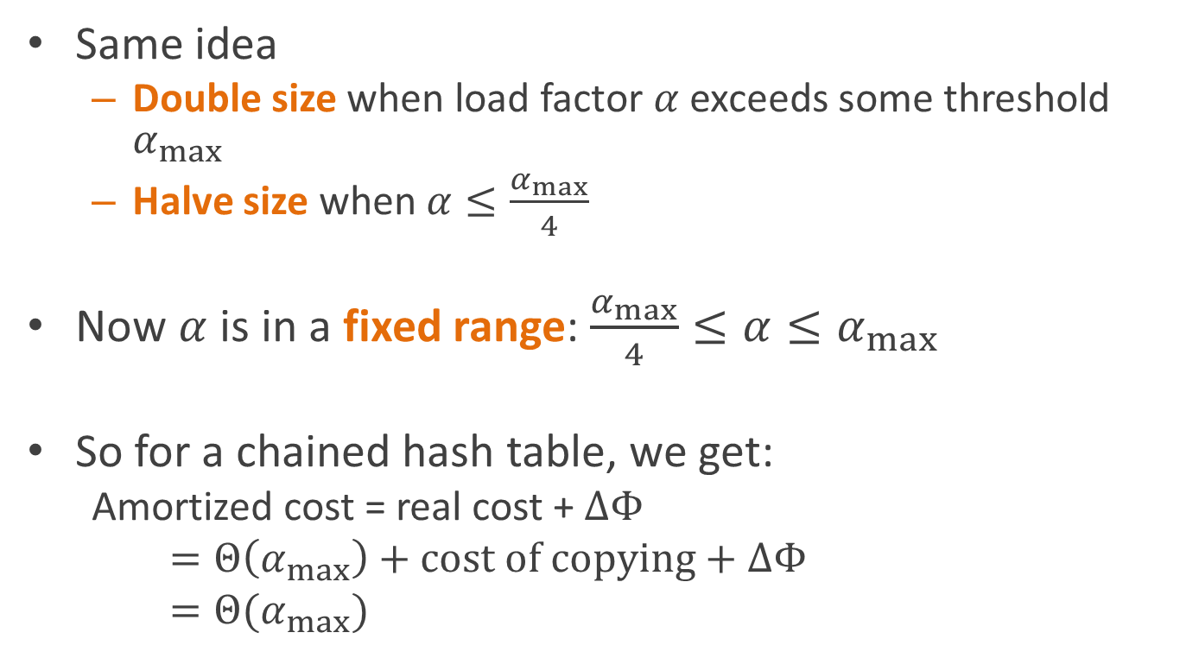
Amortized hash table
Same idea
  Double size when load factor $α$exceeds some threshold $α_{max}$
  Halve size when $α≤\frac{α_{max}}{4}$
Now $α$ is in a fixed range:$\frac{α_{max}}{4}≤α≤α_{max}$
So for a chained hash table, we get:
  Amortized cost = real cost + $ΔΦ$
  $=Θ\left(α_{max}\right)+cost of copying+ΔΦ$
  $=Θ(α_{max})$

Slide 25
Finally! Real Constant-time performance for Hash Tables!

Slide 26
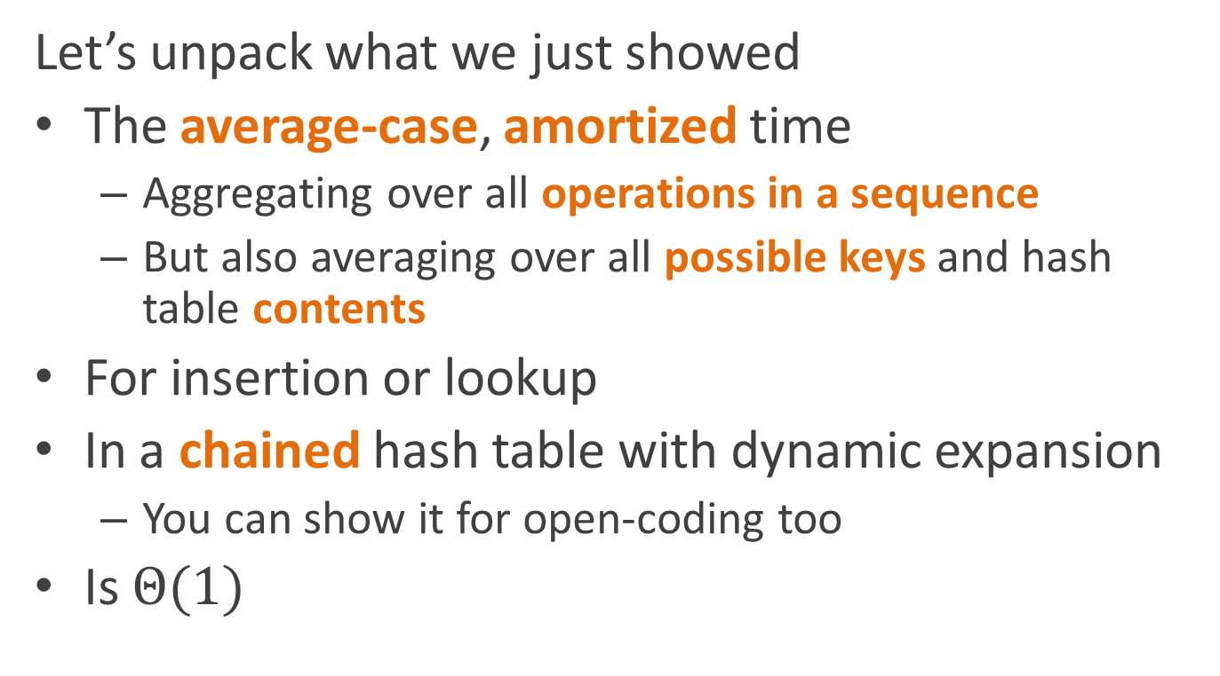
Well, almost …
Let’s unpack what we just showed
The average-case, amortized time
  Aggregating over all operations in a sequence
  But also averaging over all possible keys and hash table contents
For insertion or lookup
In a chained hash table with dynamic expansion
  You can show it for open-coding too
Is $Θ(1)$

Slide 27
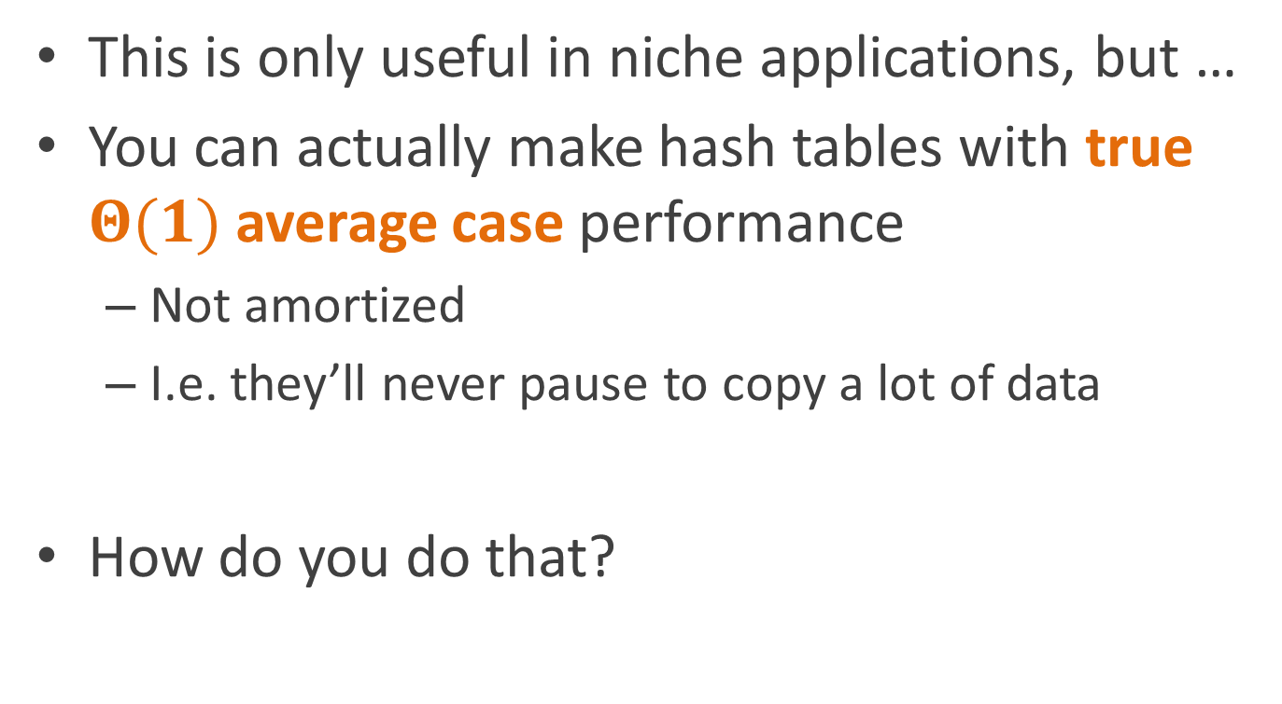
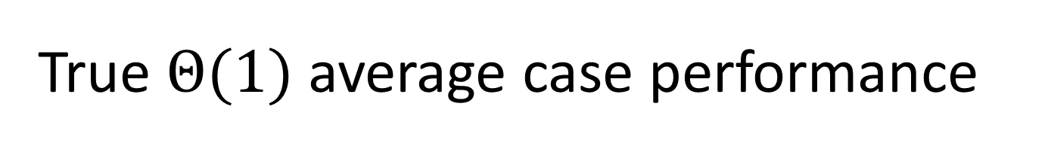
True $Θ(1)$ average case performance
This is only useful in niche applications, but …
You can actually make hash tables with true $Θ(1)$ average case performance
  Not amortized
  I.e. they’ll never pause to copy a lot of data
How do you do that?

Slide 28
Basic idea
We got the amortized time bound by charging insertions for the copies that happened later
What we want to do is to actually do the copying during the insertions
How do we do that?

Slide 29
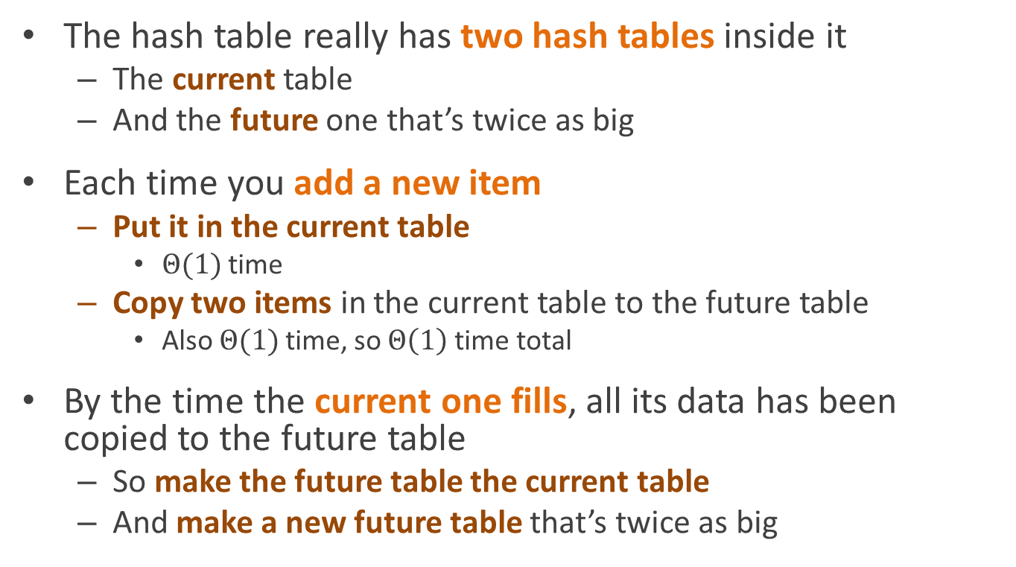
Make two hash tables!
The hash table really has two hash tables inside it
  The current table
  And the future one that’s twice as big
Each time you add a new item
  Put it in the current table
    $Θ(1)$ time
  Copy two items in the current table to the future table
    Also $Θ(1)$ time, so $Θ\left(1\right)$ time total
By the time the current one fills, all its data has been copied to the future table
  So make the future table the current table
  And make a new future table that’s twice as big

Slide 30
You can use the same trick for Arrays, stacks, etc.
Again,

Slide 31
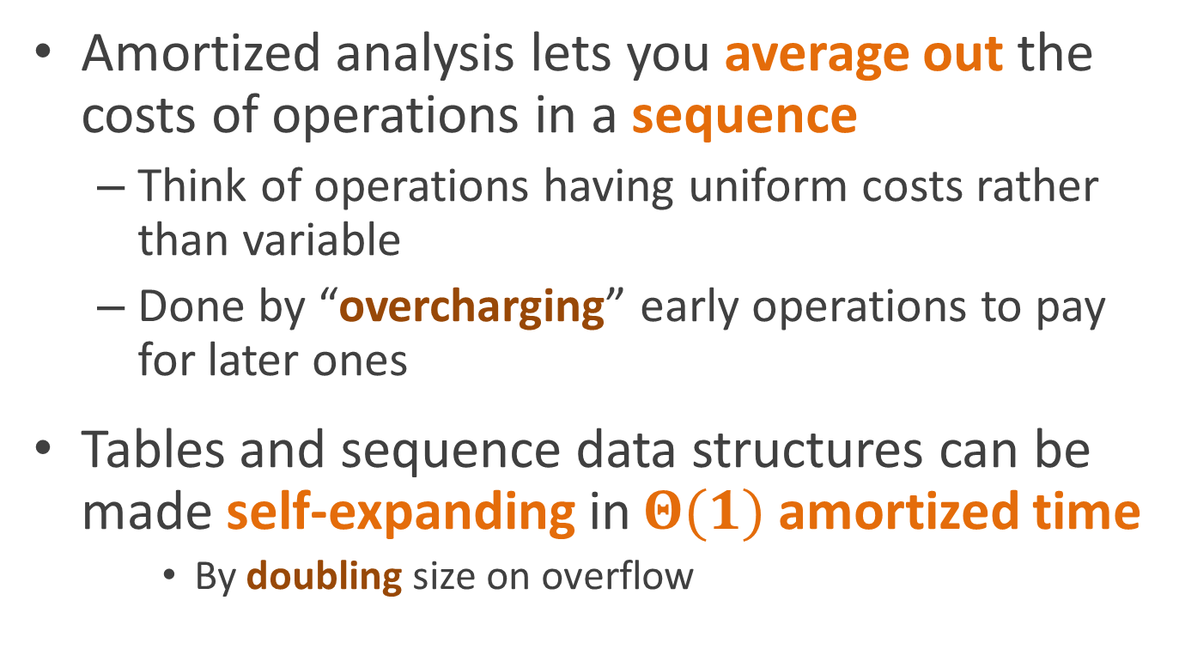
What do you need to know about this for the quiz?
Amortized analysis lets you average out the costs of operations in a sequence
  Think of operations having uniform costs rather than variable
  Done by “overcharging” early operations to pay for later ones
Tables and sequence data structures can be made self-expanding in $Θ(1)$ amortized time
    By doubling size on overflow

Slide 32
Optional reading
CLR Chapter 17
  Particularly 17.4

